Slide 1


Bone Anatomy
Dr. Mahdi H. Hammadi
PhD Sc. Clinical Physiology

Slide 2
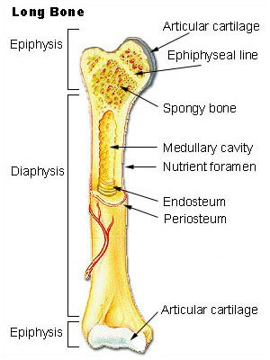

Slide 3
At birth, each long bone is made of three individual bones separated by hyaline cartilage.
Each end bone is called an epiphysis (epi = on; physis = to grow)
While the middle bone is called a diaphysis (dia = passing through).
The epiphyses and diaphysis grow towards one another and eventually fuse into one bone.
The region of growth and eventual fusion in between the epiphysis and diaphysis is called the metaphysis (meta = after).
Once the long bone parts have fused together, the only hyaline cartilage left in the bone is found as articular cartilage on the ends of the bone that form joints with other bones. The articular cartilage acts as a shock absorber and gliding surface between the bones to facilitate movement at the joint

Slide 4
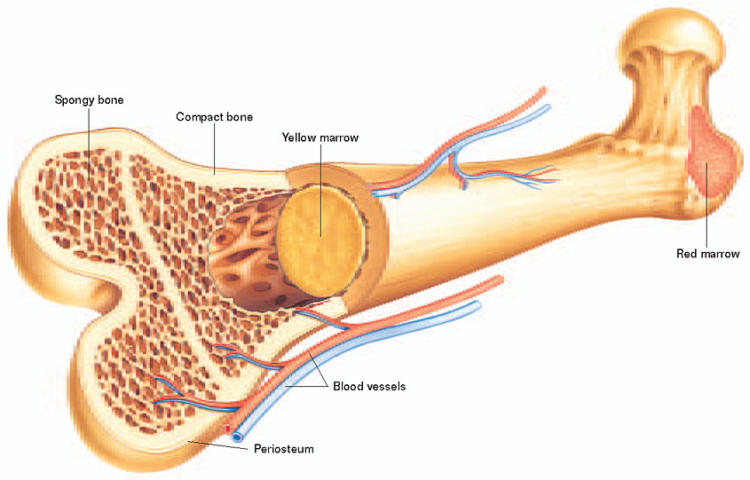

Slide 5
Looking at a bone in cross section :
There are several distinct layered regions that make up a bone.
The outside of a bone is covered in a thin layer of dense irregular connective tissue called the periosteum.
The periosteum contains:
Strong collagen fibers that are used to firmly anchor tendons and muscles to the bone for movement.
Stem cells and osteoblast cells in the periosteum are involved in the growth and repair of the outside of the bone due to stress and injury.
Blood vessels present in the periosteum provide energy to the cells on the surface and inside of the bone.
Nervous tissue and many nerve endings to give bone its sensitivity to pain when injured.

Slide 6
Deep to the periosteum is the compact bone
Compact bone is made of a matrix of hard mineral salts reinforced with tough collagen fibers. Many tiny cells called osteocytes live in small spaces in the matrix and help to maintain the strength and integrity of the compact bone.

Slide 7
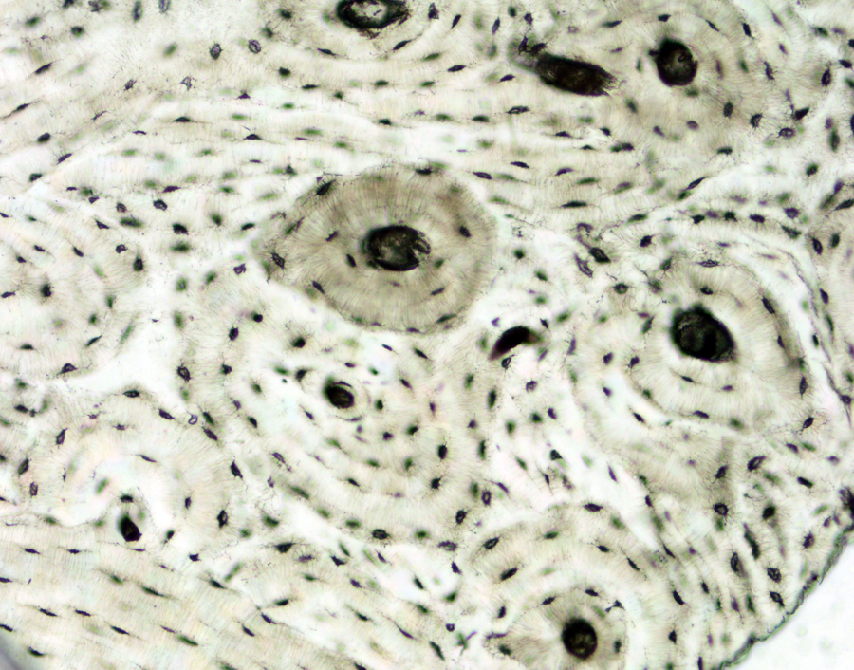

Slide 8
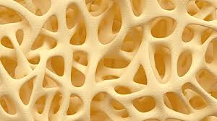
Deep to the compact bone layer is a region of spongy bone
Keeping bones light but strong. Long bones have a spongy bone on their ends but have a hollow medullary cavity in the middle of the diaphysis. The medullary cavity contains red bone marrow during childhood, eventually turning into yellow bone marrow after puberty.

Slide 9
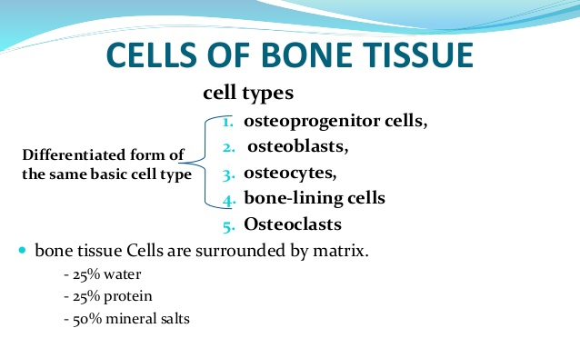

Slide 10
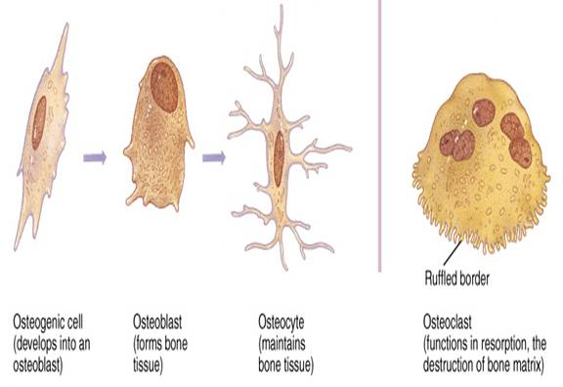

Slide 11
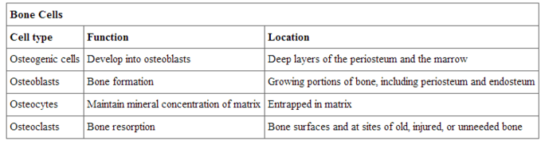

Slide 12
